Slide 2
learn services offered by HIVE
explore concepts of HIVEQL

Slide 3
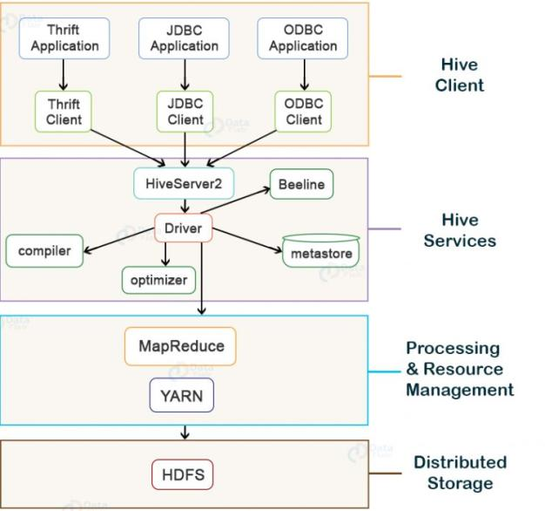
Introduction
HIVE Architecture

Slide 4
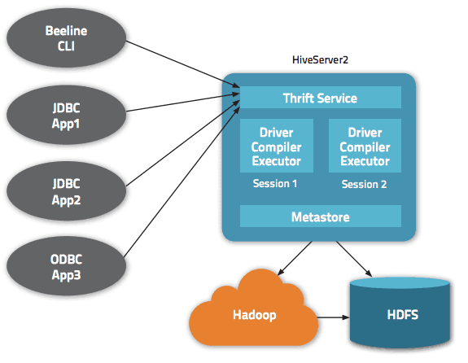
Services offered by HIVE
Beeline

Slide 5
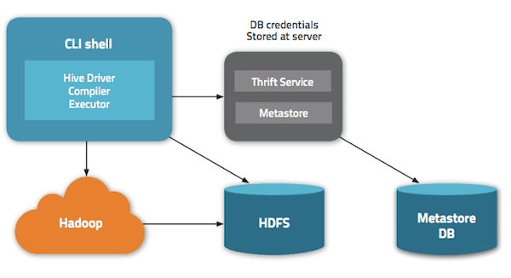
Services offered by HIVE
HIVE Server2

Slide 6
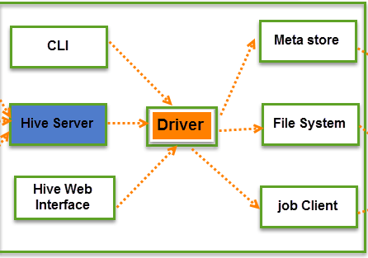
Services offered by HIVE
HIVE Driver

Slide 7
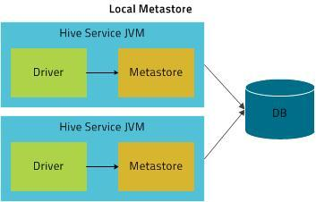
Services offered by HIVE
HIVE Complier

Slide 8
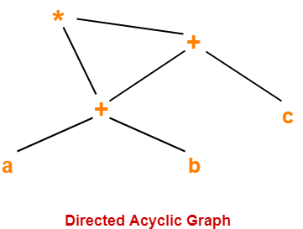
Services offered by HIVE
HIVE Complier

Slide 9
Services offered by HIVE
Optimizer

Slide 10
Services offered by HIVE
Optimization Techniques
  Tez-Execution Engine in Hive

Slide 11
Services offered by HIVE
Optimization Techniques
  Tez-Execution Engine in Hive
  Usage of Suitable File Format in Hive

Slide 12
Services offered by HIVE
Optimization Techniques
  Tez-Execution Engine in Hive
  Usage of Suitable File Format in Hive
  Hive Partitioning

Slide 13
Services offered by HIVE
Optimization Techniques
  Tez-Execution Engine in Hive
  Usage of Suitable File Format in Hive
  Hive Partitioning
  Bucketing in Hive

Slide 14
Services offered by HIVE
Optimization Techniques
  Tez-Execution Engine in Hive
  Usage of Suitable File Format in Hive
  Hive Partitioning
  Bucketing in Hive
  Vectorization In Hive

Slide 15
Services offered by HIVE
Optimization Techniques
  Tez-Execution Engine in Hive
  Usage of Suitable File Format in Hive
  Hive Partitioning
  Bucketing in Hive
  Vectorization In Hive
  Cost-Based Optimization in Hive (CBO)

Slide 16
Services offered by HIVE
Optimization Techniques
  Tez-Execution Engine in Hive
  Usage of Suitable File Format in Hive
  Hive Partitioning
  Bucketing in Hive
  Vectorization In Hive
  Cost-Based Optimization in Hive (CBO)
  Hive Indexing

Slide 17
Services offered by HIVE
Execution Engine

Slide 18
Services offered by HIVE
Execution Engine
The execution engine uses Hadoop to execute the execution plan created by the compiler in order of their dependencies following the compilation and optimization processes.

Slide 19
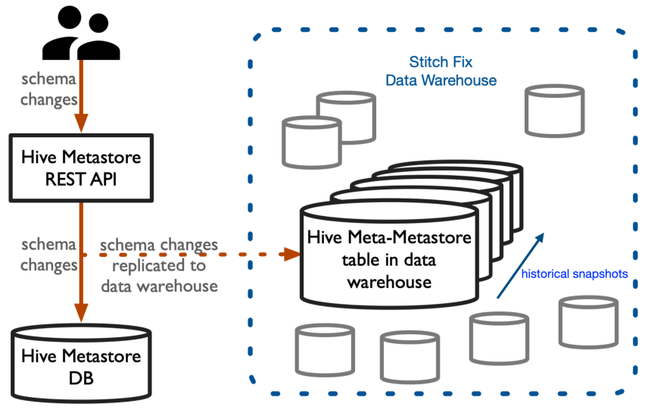
Services offered by HIVE
MetaStore

Slide 20
Services offered by HIVE
MetaStore
Metastore can be configured in one of two ways
Remote
Embedded

Slide 21
Services offered by HIVE
MetaStore
It also holds serializer and deserializer metadata, which is essential for read/write operations, as well as HDFS files where data is kept. In most cases, this metastore is a relational database.For searching and altering Hive metadata, Metastore provides a Thrift interface.

Slide 22
Services offered by HIVE
MetaStore
It also holds serializer and deserializer metadata, which is essential for read/write operations, as well as HDFS files where data is kept. In most cases, this metastore is a relational database.For searching and altering Hive metadata, Metastore provides a Thrift interface.

Slide 23
Services offered by HIVE
MetaStore
Metastore can be configured in one of two ways:
  Remote: Metastore is a Thrift service in remote mode, which is suitable for non-Java applications.
  Embedded: In embedded mode, the client can use JDBC to interface directly with the metastore.

Slide 24
Services offered by HIVE
HCatalog
Hadoop's table and storage management layer is HCatalog. It allows users to read and write data on the grid using various data processing tools such as Pig, MapReduce, and others.It is based on Hive metastore and exposes Hive metastore's tabular data to other data processing tools.

Slide 25
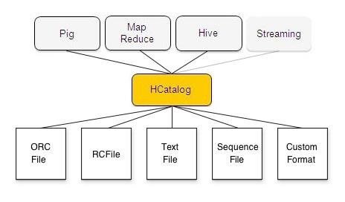
Services offered by HIVE
HCatalog

Slide 26
Services offered by HIVE
HCatalog
HCatalog is a Hadoop table and storage management layer that allows users to read and write data on the grid more simply using various data processing tools such as Pig and MapReduce. Users can have a relational view of data in the Hadoop distributed file system (HDFS) thanks to HCatalog's table abstraction, which means they don't have to worry about where or how their data is stored — RCFile format, text files, SequenceFiles, or ORC files.

Slide 27
Services offered by HIVE
HCatalog
HCatalog supports reading and writing files in any format for which a SerDe (serializer-deserializer) can be written. By default, HCatalog supports RCFile, CSV, JSON, and SequenceFile, and ORC file formats. To use a custom format, you must provide the InputFormat, OutputFormat, and SerDe.

Slide 28
Services offered by HIVE
WebHCat
For HCatalog, WebHCat is the REST API. It's a Hive metadata operations HTTP interface. It lets users perform Hadoop MapReduce (or YARN), Pig, and Hive jobs.

Slide 29
Services offered by HIVE
WebHCat
Developers use HTTP requests to access Hadoop MapReduce (or YARN), Pig, Hive, and HCatalog DDL from within applications, as demonstrated in the diagram below. HDFS stores the data and code utilised by this API. When HCatalog DDL commands are requested, they are immediately executed. WebHCat (Templeton) servers queue MapReduce, Pig, and Hive jobs, which may be monitored for progress or cancelled as needed. Pig, Hive, and MapReduce results are stored in HDFS, and developers select where they should be stored.

Slide 30
Services offered by HIVE
URL Format

Slide 31
HIVE QL

Slide 32
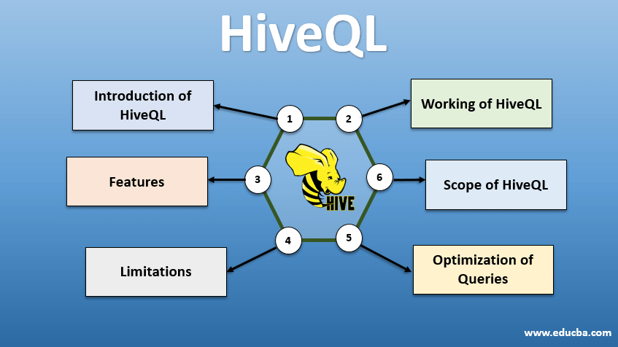
HIVE QL

Slide 33
HIVE QL

Slide 34
HIVE QL
Syntax

Slide 35
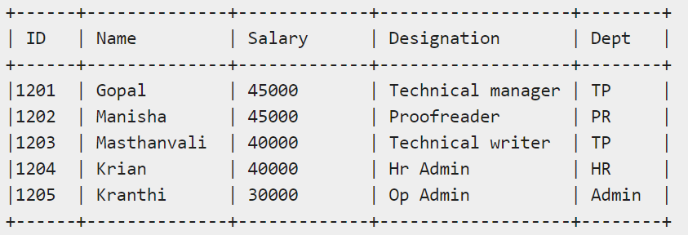
HIVE QL
Example
Let us take an example for SELECT…WHERE clause. Assume we have the employee table as given below, with fields named Id, Name, Salary, Designation, and Dept. Generate a query to retrieve the employee details who earn a salary of more than Rs 30000.

Slide 36
HIVE QL
Query

Slide 37
HIVE QL
JDBC Program
import java.sql.SQLException;
import java.sql.Connection;
import java.sql.ResultSet;
import java.sql.Statement;
import java.sql.DriverManager;
public class HiveQLWhere {
private static String driverName = "org.apache.hadoop.hive.jdbc.HiveDriver";
public static void main(String[] args) throws SQLException {
// Register driver and create driver instance
Class.forName(driverName);
// get connection
Connection con = DriverManager.getConnection("jdbc:hive://localhost:10000/userdb", "", "");

Slide 38
HIVE QL
JDBC Program
// create statement
Statement stmt = con.createStatement();
// execute statement
Resultset res = stmt.executeQuery("SELECT * FROM employee WHERE salary>30000;");
System.out.println("Result:");
System.out.println(" ID \t Name \t Salary \t Designation \t Dept ");
while (res.next()) {
System.out.println(res.getInt(1) + " " + res.getString(2) + " " + res.getDouble(3) + " " + res.getString(4) + " " + res.getString(5));
}
con.close();
}
}

Slide 39
HIVE QL
Save the program in a file named HiveQLWhere.java. Commands to compile and execute this program.

Slide 40
HIVE QL
ORDER BY clause in a SELECT statement.

Slide 41
HIVE QL
ORDER BY
Syntax

Slide 42
HIVE QL
Example
Let us take an example for SELECT...ORDER BY clause. Assume employee table as given below, with the fields named Id, Name, Salary, Designation, and Dept. Generate a query to retrieve the employee details in order by using Department name.

Slide 43
HIVE QL
Query

Slide 44
HIVE QL
GROUP BY

Slide 45
HIVE QL
Syntax

Slide 46
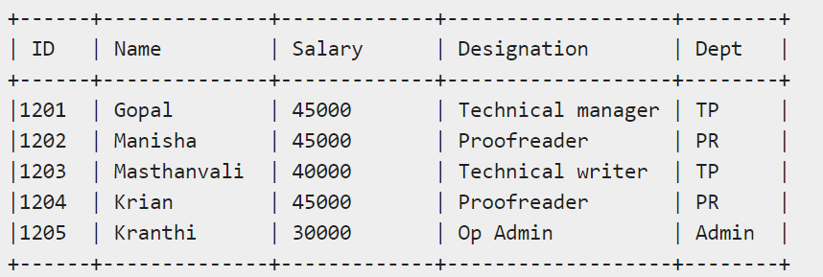
HIVE QL
Example
Let us take an example of SELECT…GROUP BY clause. Assume employee table as given below, with Id, Name, Salary, Designation, and Dept fields. Generate a query to retrieve the number of employees in each department.

Slide 47
HIVE QL
Query

